Slide 1
Blueprint for pasture-based dairy cows
The right cow depends upon your system
Richard Shephard BVSc MVS PhD

Slide 2

Richard Shephard
Veterinarian, epidemiologist, farm management consultant
Managed InCalf Project for Dairy Australia
Explored role of genetics in pasture-based dairying
Completed case studies examining cow-level and herd-level changes on farms

Slide 3
Topics
Cow-level performance versus herd-level performance
  Production
  Fertility
My suggestions for ideal cow for pasture-based dairying
Case studies
  Conversion from pure-bred to cross-bred cows in grazing system
  Fertility as the driver of long-term farm profitability

Slide 4
Cow-level versus herd-level performance
Atomistic fallacy—assuming differences between cow types mean herds with different cow types always perform differently
  E.g. Cows of higher production capacity (once) had lower fertility.
  Many high-cow-producing herds were found to have higher fertility than low-cow-producing herds.
  Management made the difference!
Just because herds have different cow types does not mean they always will perform differently
Notes:
Example is once a cow with high production often had lower fertility. But wrong to assume higher-producing herds have lower fertility than lower-producing herds. Better management = better nutrition = better performance everywhere

Slide 5
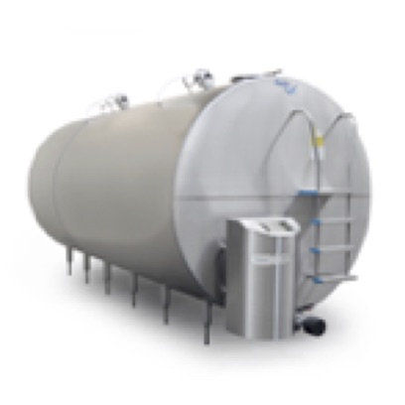
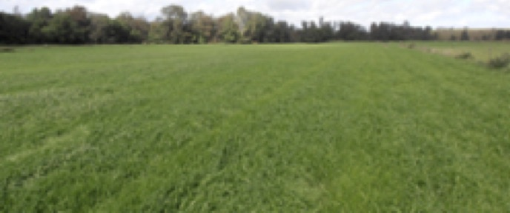
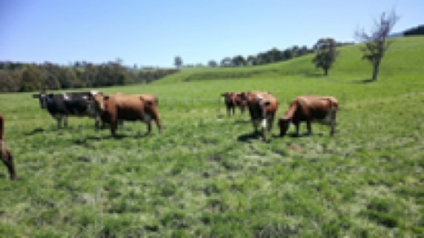
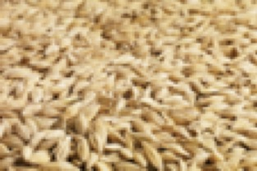
Cow productivity versus land productivity
Which should we optimise? Land or cow?
Dairy farm land is worth 2+ times the value of the dairy herd
Cows are intermediary in the milk production supply chain
Land (pasture) is the primary generator of production

Slide 6
Optimise the cow or the land
Superior cows produce more milk than inferior cows at low stocking rates.
  Cows are optimised at low stocking rates
Pasture use optimises at high stocking rate
  Differences in cow production between superior and inferior cows lessen
  Herd production ceiling is set by pasture
Total farm production is mostly independent of cow type at high stocking rate
  Determined by amount pasture consumed
Try to optimise the suite of resources

Slide 7
Pasture use efficiency
Poor pasture use efficiency at low stocking rate
  Cows have few constraints so perform to potential
Pasture use efficiency maximizes at high stocking rate
  Cows are now somewhat underfed…
High-producing cows eat more so you need fewer to eat all feed resources than for low-producing cows

Slide 8
If only it were than simple…
Average/total production tells nothing about efficiency
Critical to know efficiency of last unit of production
Cow types may differ in their efficiency at converting feed into milk
ALL cows require different amounts of feed to produce an extra litre of milk
Be careful interpreting average physical benchmarks!
Marginal response curve

Slide 9
Inefficiency
More milk per cow may not be profitable if it too much feed is needed to get that last litre…
Situations exist where it will be better to give extra feed to a hungrier cow—she will make more milk with it
Practically, you use stocking rate to redistribute pasture and keep herd most efficient

Slide 10
In economic terms
Moving from the left curve to the right curve (via stocking rate)
  Reduce cow production but increase feed conversion efficiency
The farm may make now more milk from the same inputs

Slide 11
What clues about efficiency can we get?
1 kg DM pasture/concentrate contain 11–12 MJ ME
Cows making 1 L milk (75 grams milk solids) requires 5.0–9.4 MJ
Could produce between 0.5–2 litres of milk from 1 kg extra grain
If herd regularly returns >1L (75gm MS) per kg supplement, cows are likely on an efficient part of the curve

Slide 12
Should we keep stacking the cows on?
Certainly not! Once stocking rate ensures most pasture is consumed, additional cows get most of their intake as supplement
Remember, you need 1.7-2.0 tonnes of feed for maintenance, pregnancy
Milk:concentrate price ratio rarely favourable for this to be profitable
Why buy pasture land and run a feedlot?

Slide 13
What can we conclude about production?
Profitability primarily determined by pasture consumption. Stocking rate is key.
Herds of lower-merit cows can produce at least as much milk from the (limited) feed base as herds of higher-merit cows
Set stocking rate to consume all pasture. This requires supplementation to maintain body condition and fertility.
Monitor herd milk response to supplement – is it efficient (>1L/kg)?
Ask yourself: Did you profit from the last litre of milk you produced?

Slide 14
Fertility & pasture-based (seasonal) dairying
Declining cow fertility has two main impacts: depreciation & risk
Low fertility cows are lost prematurely. Herd depreciation increases
Harder to maintain seasonal calving with low fertility cows.
Changing when cows calve may increase failed season risk
We have seen this in the Australian industry across the past 20 years

Slide 15
Herd depreciation – a real cost
Think of cull cows as an expense, not a source of income
Your loss is the replacement value less the cull cow return
Annual loss is determined by how long she remains in the herd
Aim to have a low replacement rate. Rates of 18–20% are achievable
Component | Value ($AUD)
Point-of-calving heifer | $2,500
Cull cow | $750
Depreciation | $1,750
If the cow lasts…1 yr | $1,750 p.a.
2 yr | $875 p.a.
3 yr | $583 p.a.
4 yr | $438 p.a.
5 yr | $350 p.a.
6 yr | $292 p.a.

Slide 16
Adding one more productive year
Increasing from 5 to 6 lactations per cow will reduce cow depreciation from $350 to $292 per annum
  A saving of around $60
You would need to produce an extra 20 kg milk solids
  At milk price of $6.00 kg & (efficient) marginal cost of production of $3.00 kg
This means a 447 kg MS/Year x 5 lactation cow has the same annual profitability as a 427 kg MS/Year x 6 lactation cow
Need to consider capital and running (depreciation) costs to estimate profit

Slide 17
Fertility and risk – changing calving pattern
Warragul, Victoria, Australia
(dry-land, high rainfall, late-winter/spring calving)
The ‘average’ season is not the one that hurts you
Rainfall patterns (in Australia) do not support additional calving times
It is very difficult to manage cows that calve into no green feed
Despite what the factory pays! It’s not a premium…
Season | Season average rainfall (mm) | % of years with > 225 mm per season (75 mm/month)
Autumn | 244 | 53%
Winter | 268 | 74%
Spring | 289 | 80%
Summer | 194 | 31%

Slide 18
Production & fertility: cost of production
Increased cow productivity
Need to purchase or grow more feed—or she just steals from herd mates
Marginal feed costs tend to be higher than pasture feed cost
Increased cow productivity may increase your cost of production
Increased cow fertility
Cows may have more lactations—this decreases herd depreciation
Herd calving pattern can be more easily managed to fit pasture growth
Improved fertility may reduce your cost of production

Slide 19
The ideal cow for pasture-based dairying
Absolute must haves:
High fertility
Efficient grazers
Efficient feed converters
These cows tend to be of modest size and production. The FxJ crossbreed…
More focus on herd efficiency, less focus on cow production potential. A well managed herd will offset many apparent cow deficiencies

Slide 20
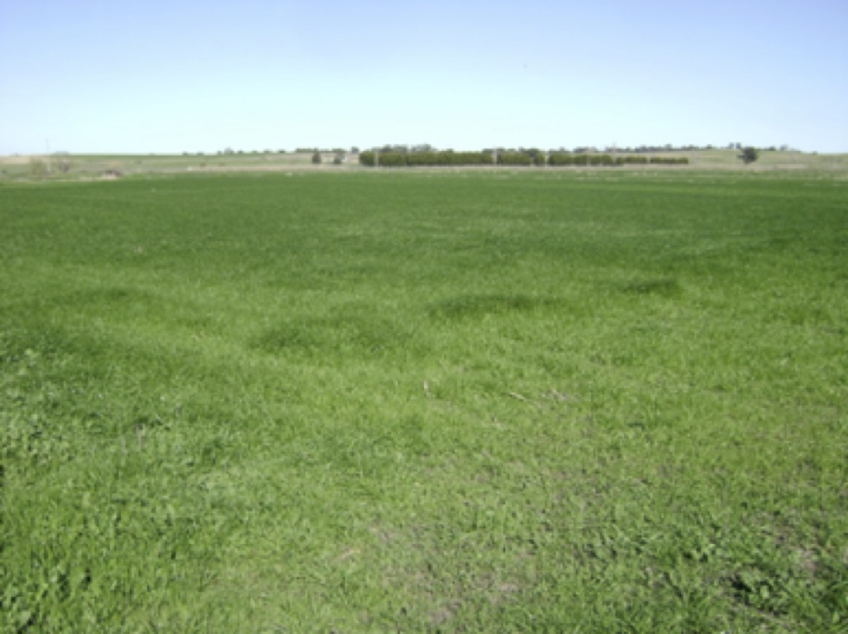
Case Study 1. Malmo & van Wees
Seasonal (spring) calving, pasture-based (irrigation) herd
Cows fed 1-2 T/cow/year concentrate
Originally, HF, then two-way cross(with J) around 20 years ago. Now 3x cross
Complete physical and financial records

Slide 21
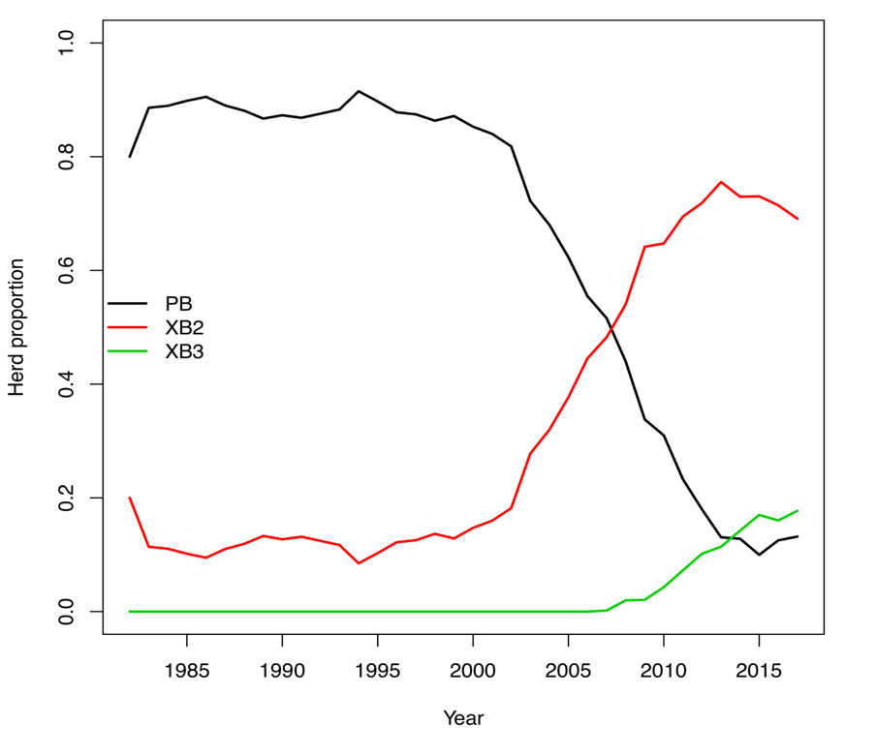
Crossbreeding
Two-way cross predominated from 2006
Three-way cross has not yet stabilised in herd
A few pure-bred HF remain

Slide 22
Stocking rate
Stocking rate increased as the herd converted to the smaller crossbreed

Slide 23
Trends in cow and hectare milk production
Cow annual production is increasing
Hectare annual production is increasing – at a faster rate than cow production

Slide 24
Cow lifetime production
Cow lifetime production is increasing at a faster rate than cow lactation production
Cows have more lactations
Fertility improvement has delivered real benefits

Slide 25
Cow and hectare gross margin trends
Cow gross margin performance plateaued for many years
Hectare gross margin has consistently increased
Stocking rate was used to offset smaller cow effect

Slide 26
Malmo & van Wees
Farmers queue to buy their cull cows
One of the only dairy sheds that shuts off in winter in my district
Jakob and Hans take regular overseas holidays when the cows are dry
11.5% return on capital in year of analysis (a low milk price year)

Slide 27
Case Study 2: AgCap
AgCap investment fund with dairy portfolio
Tasmanian farm milking 800 spring-calving cows
240 Ha, 190 Ha irrigated. High quality feed in spring and summer
Consume 3.2T DM/Cow/Yr; 11 T pasture DM/Ha/Yr
Grain prices are high in Tasmania; pasture is lowest cost feed
Produce 480 kg MS/cow/yr; 1,620 kg MS/Ha/Yr
Fertility is the key to farm profitability & sustainability

Slide 28
Reproduction: key to performance
Good reproductive performance is a key to a simple and profitable farming system. It assists us in maintaining our simple system
Cows provide 6 lactations on average
Herd replacement rate is 18-20%. This minimizes depreciation
Cost savings in mating program and heifer rearing
Short AI (3 weeks); short mating (8-10 weeks) keeps staff focused
Minimal interventions; the cows are fertile without much help

Slide 29
Farm performance
Farm achieved 6.00% return on assets
  In a high cost-of-production year
Ten-year profitability is in top 10% of farms
The farm is reliably profitable; year after year

Slide 30

Thank-you
Dr Richard Shephard BVSc MVS PhD
Herd Health Pty Ltd
c/o 2 Foster Street
Maffra VIC 3860
richard@herdhealth.com.au

